Slide 1



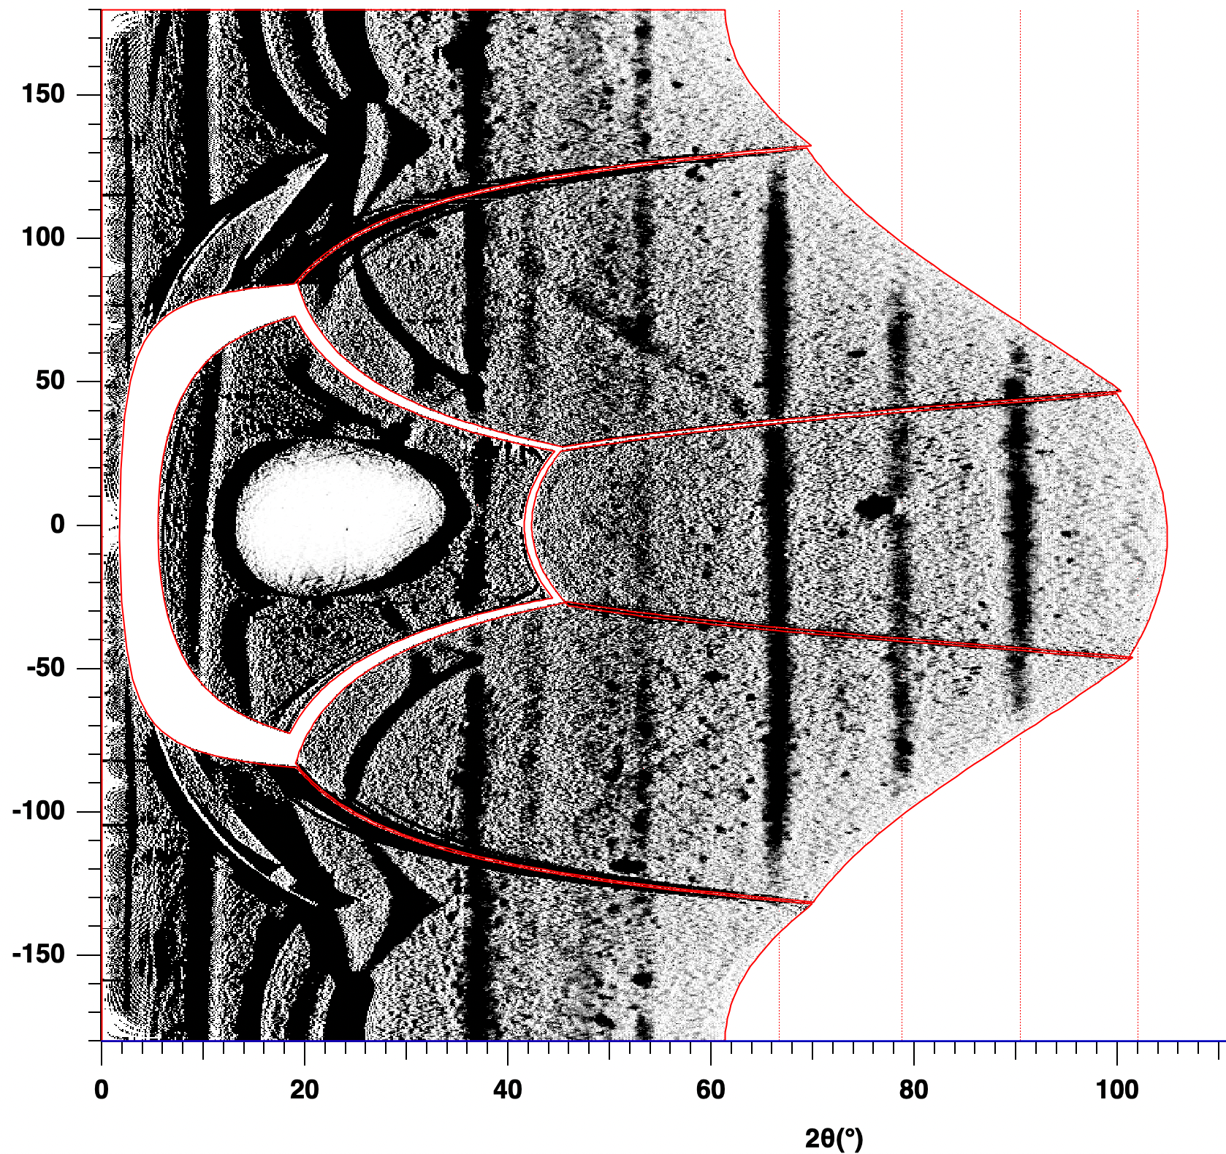
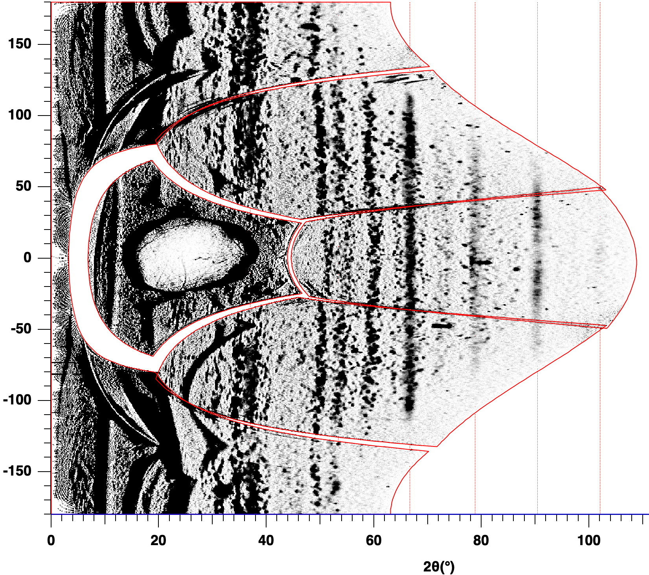
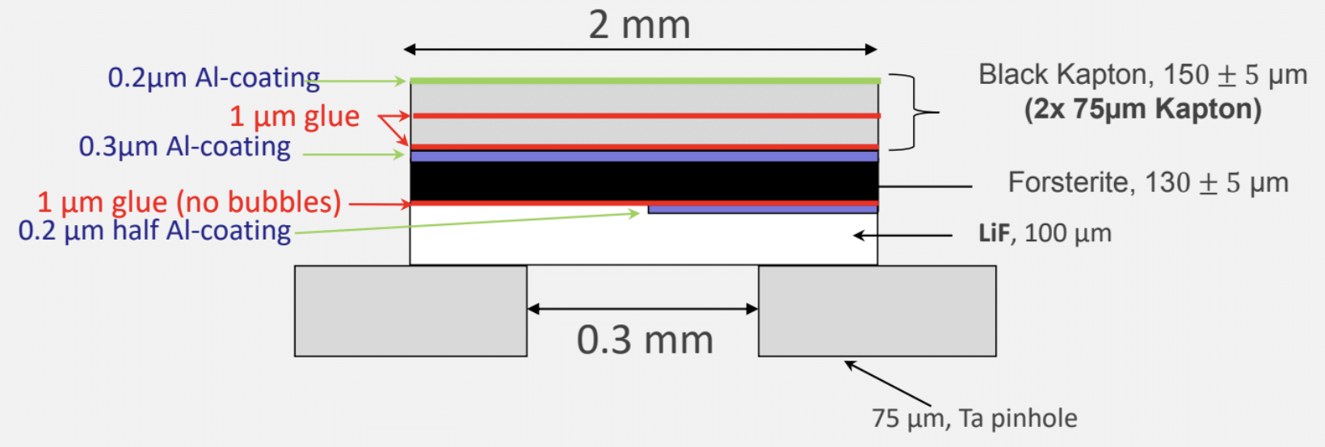
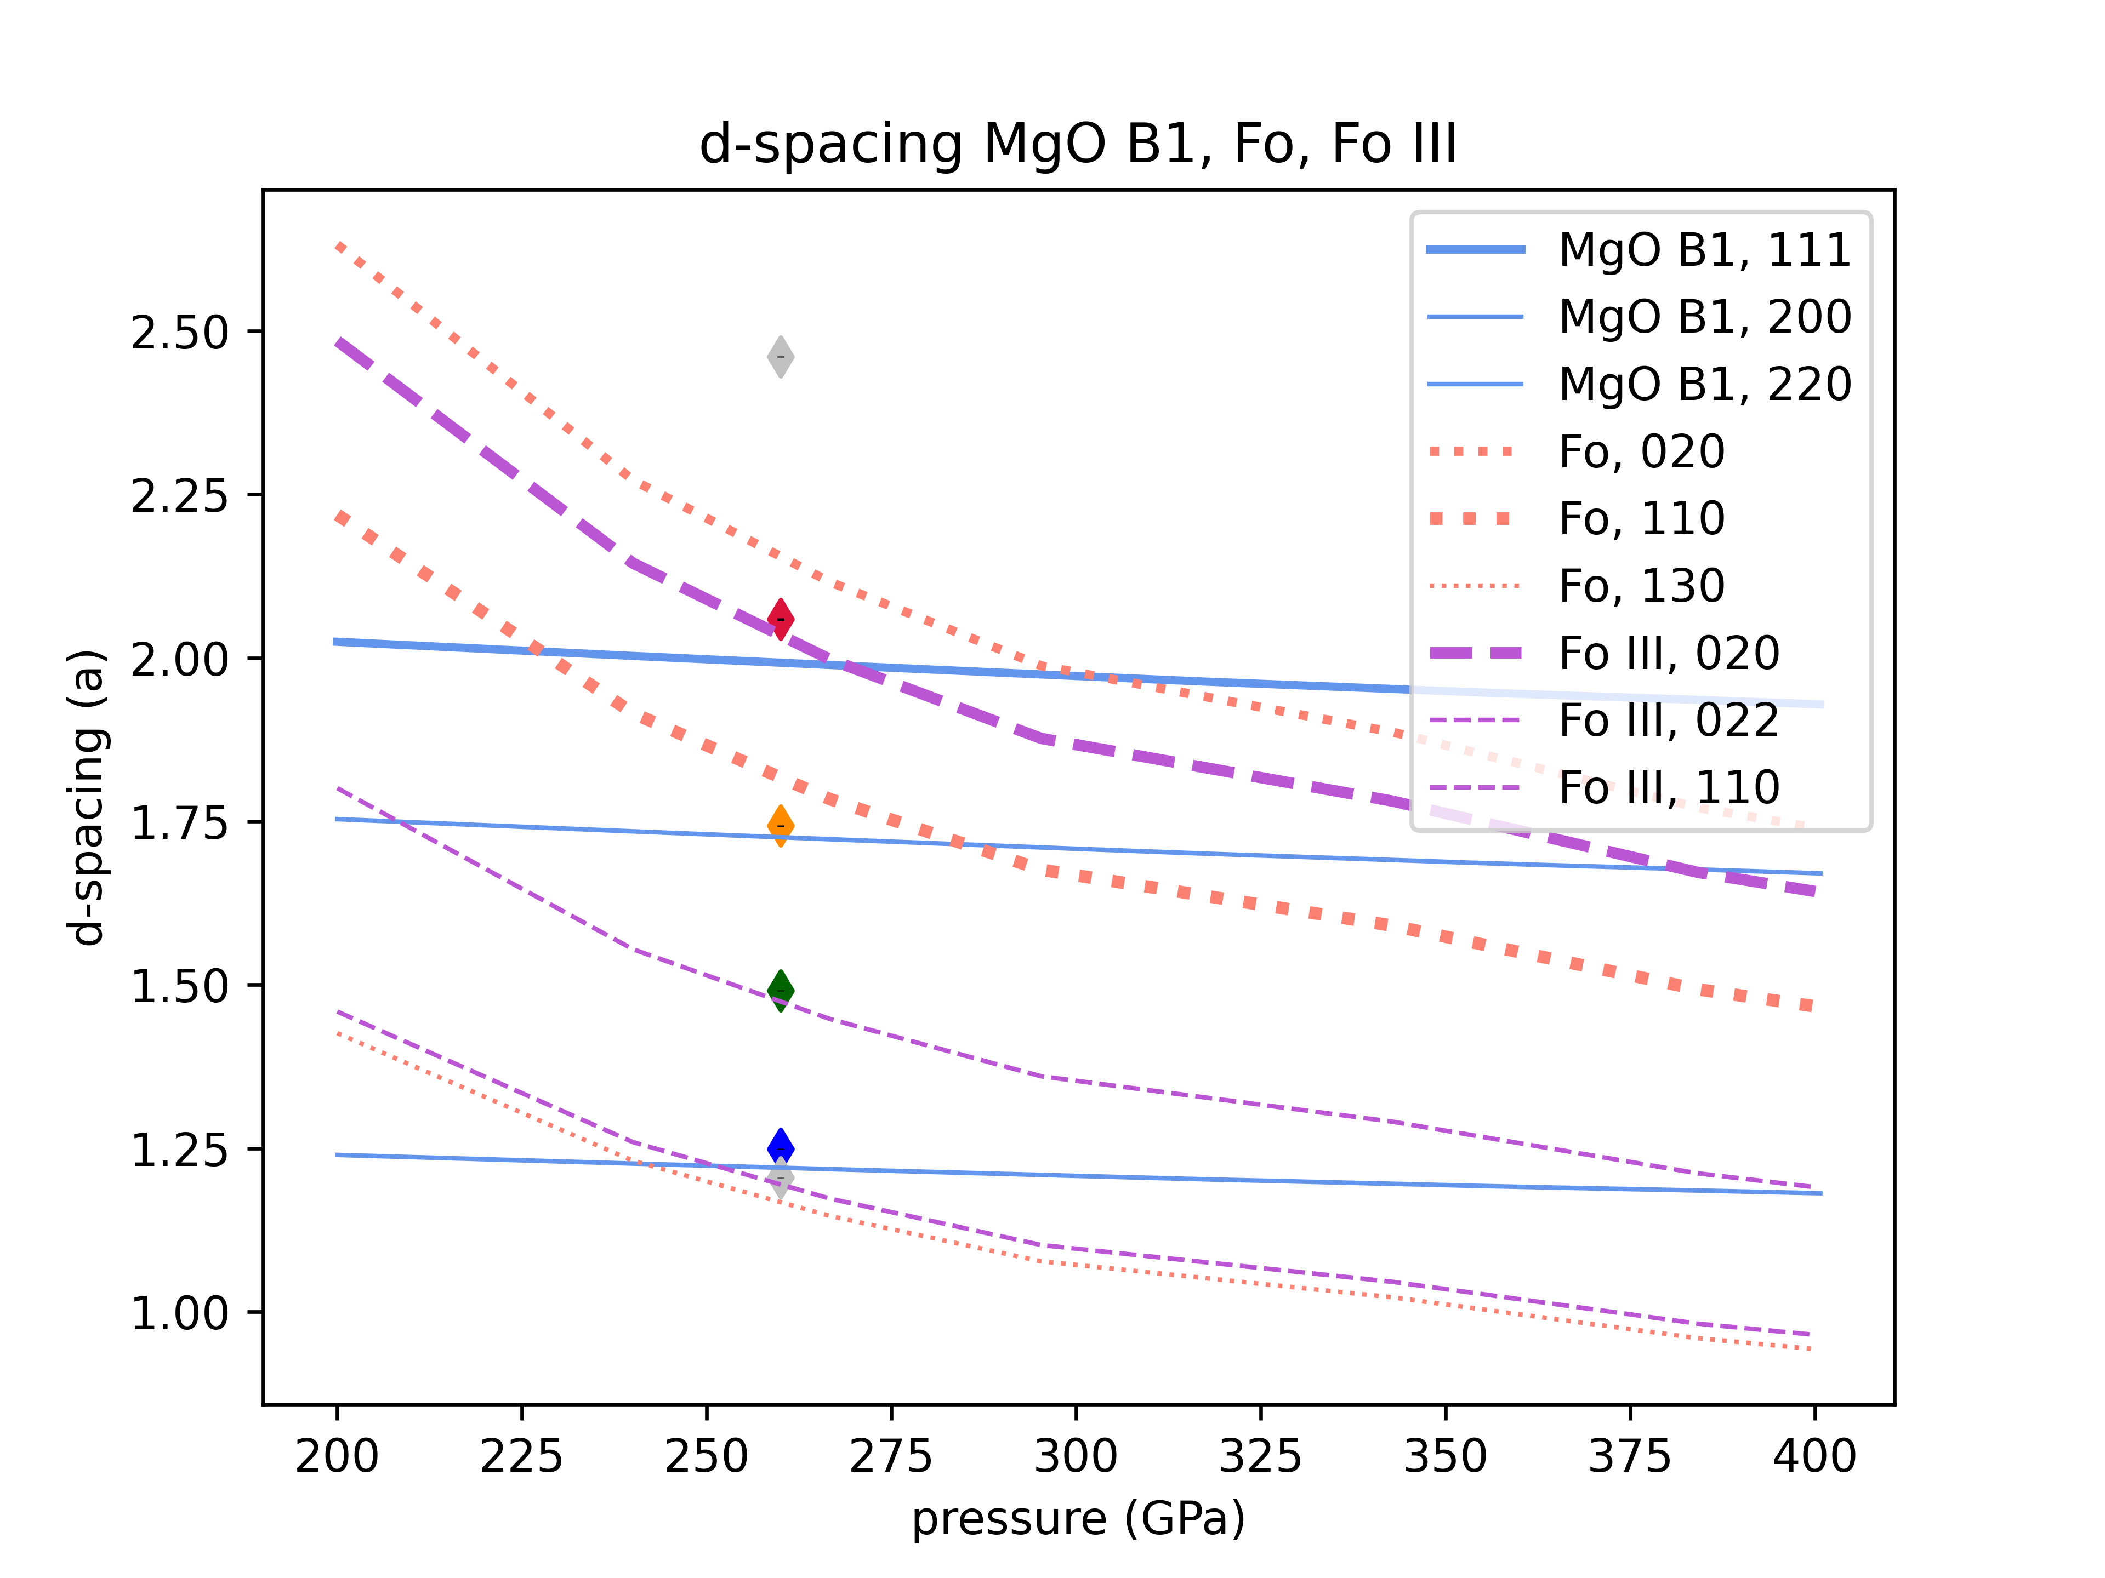
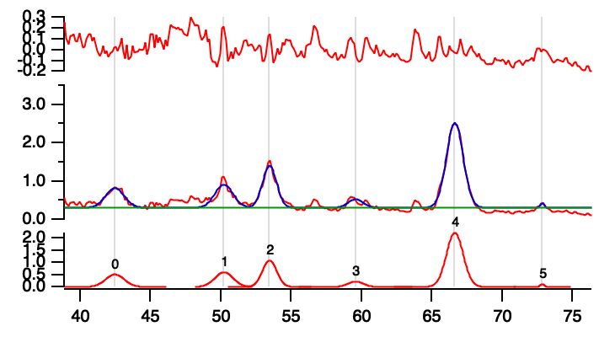
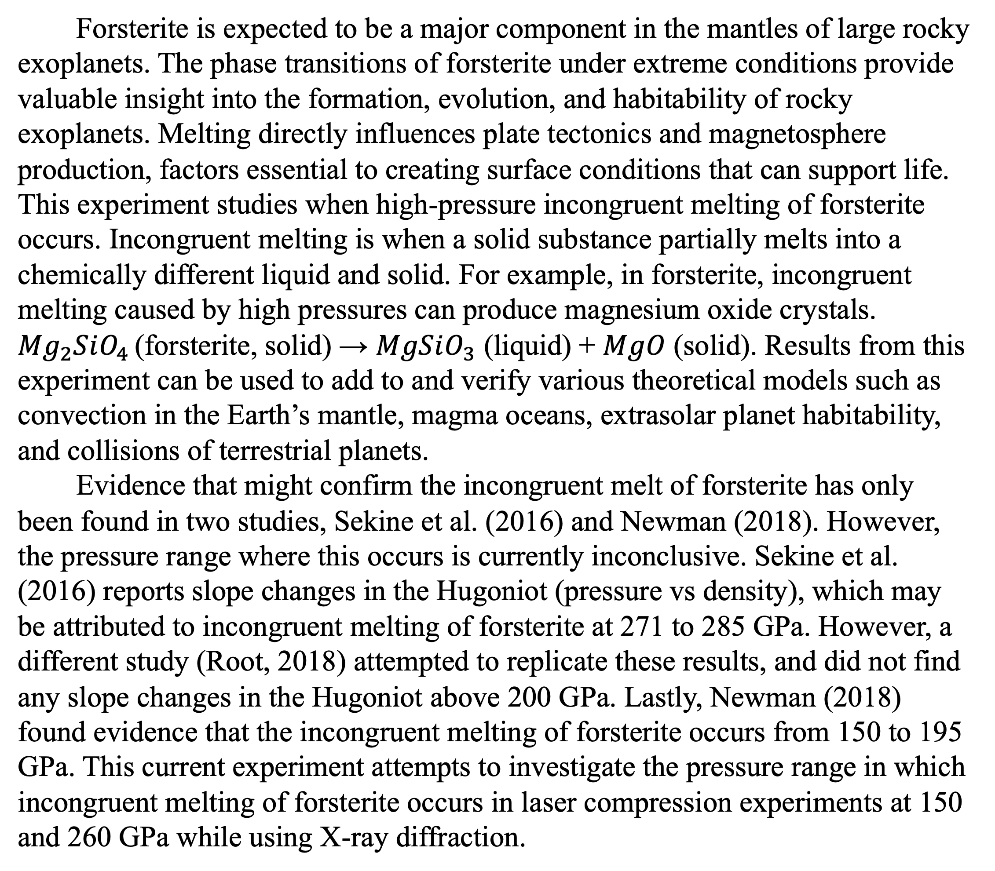
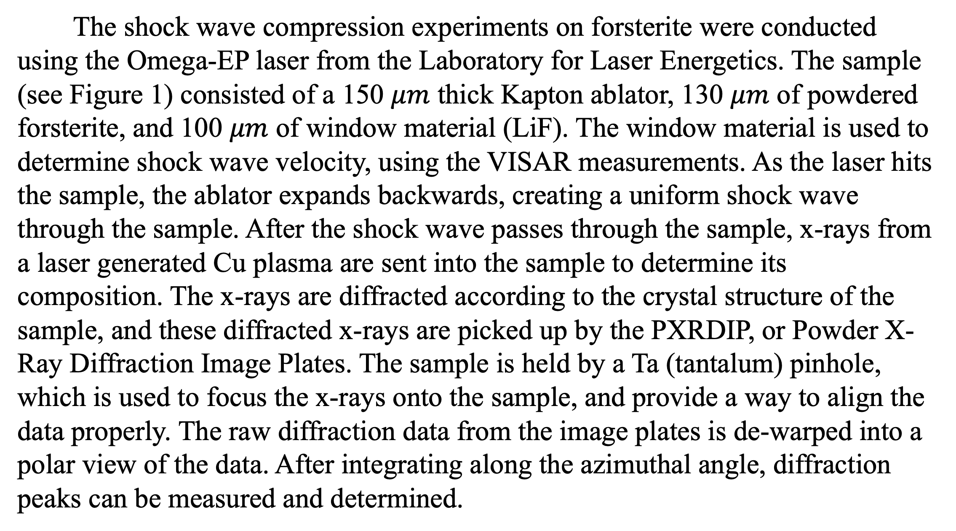
Structure of forsterite in extreme conditions
Nara Anusonti-Inthra
Mentored by Prof. June Wicks and Patrick LaChapelle
Abstract
Materials and Methods (cont.)
The phase changes of forsterite are very important due to its implications in planetary science; as a main component of the mantles of rocky planets, it can affect the habitability of the planet, among many other applications. Forsterite is expected to undergo a process called incongruent melting, but at which pressure range this occurs is currently debated. In this experiment, the Omega-EP laser was used to generate a shock wave, bringing a forsterite sample up to 150 and 260 GPa. Using diffraction data from the PXRDIP, MgO crystal and liquid forsterite peaks were found at only high pressure. This provides evidence that forsterite is incongruently melted at 260 GPa. To further confirm this data, the VISAR measurements will be used as an independent way to measure density and verify it from the PXRDIP data.
These peaks are then translated into a d-spacing value, which is a measurement of the inter-atomic spacing in the lattice. Each material, in different phases and crystal orientations, can be identified by its unique d-spacing value. Due to the pressure range of this experiment, the possible materials that can be observed are forsterite, forsterite III (shown to be found in shock compression experiments (Kim, 2020)), and MgO B1. Using the unit cell parameters of these materials, the most likely crystal orientations can be mathematically predicted. An expected d-spacing graph can then be made for each material and compared to all the d-spacings found in the experiment in order to identify the diffraction peaks found.
Background
Figure 1: A diagram of the forsterite sample
Forsterite is expected to be a major component in the mantles of large rocky exoplanets. The phase transitions of forsterite under extreme conditions provide valuable insight into the formation, evolution, and habitability of rocky exoplanets. Melting directly influences plate tectonics and magnetosphere production, factors essential to creating surface conditions that can support life. This experiment studies when high-pressure incongruent melting of forsterite occurs. Incongruent melting is when a solid substance partially melts into a chemically different liquid and solid. For example, in forsterite, incongruent melting caused by high pressures can produce magnesium oxide crystals. ${Mg}_{2}SiO_{4 }$(forsterite, solid) → $MgSiO_{3}$ (liquid) + $MgO$ (solid). Results from this experiment can be used to add to and verify various theoretical models such as convection in the Earth’s mantle, magma oceans, extrasolar planet habitability, and collisions of terrestrial planets.
Evidence that might confirm the incongruent melt of forsterite has only been found in two studies, Sekine et al. (2016) and Newman (2018). However, the pressure range where this occurs is currently inconclusive. Sekine et al. (2016) reports slope changes in the Hugoniot (pressure vs density), which may be attributed to incongruent melting of forsterite at 271 to 285 GPa. However, a different study (Root, 2018) attempted to replicate these results, and did not find any slope changes in the Hugoniot above 200 GPa. Lastly, Newman (2018) found evidence that the incongruent melting of forsterite occurs from 150 to 195 GPa. This current experiment attempts to investigate the pressure range in which incongruent melting of forsterite occurs in laser compression experiments at 150 and 260 GPa while using X-ray diffraction.
Figure 2: Diffraction patterns from the PXRDIP data of shocked forsterite at 260 GPa
Figure 5: Diffraction patterns from the PXRDIP data of shocked forsterite at 150 GPa
Results
Forsterite shocked to 260 GPa contains the most promising results. After running the PXRDIP analysis (see Figure 2), a total of 6 possible diffraction peaks were found. These points were shown with the d-spacing of MgO and forsterite, the materials of interest (see Figure 3). The thicker lines mean that this particular crystal orientation is very prominent and it is more likely to be observed in experiments. On this graph, it can be seen that the very top and bottom points are grey, corresponding to the white arrows in Figure 2, which means they are unlikely to be MgO or forsterite. First off, these points could represent noise from the experiment, as they only slightly resemble diffraction points. Additionally, if they were diffraction points, they are very sharp diffraction peaks, which is characteristic of a single-crystal sample, not the powdered samples studied in this experiment. After eliminating those two points, the remaining four diffraction lines can be seen in the lineout (after integration along the azimuthal angle, see Figure 4). The two peaks not labeled are lines from the Ta pinhole. It can be inferred that the red line (at 42 2-theta) is potential proof of the presence of MgO crystallization, which needs to be investigated further, and the other three lines are diffractions from liquid forsterite. At high pressures, when crystalline melt occurs, the diffraction peak remains at around the same d-spacing value, just getting more fuzzy and less clear after the phase transition to a liquid. This is shown in our data by comparing the clearness of the lower pressure shot forsterite lines and the fuzziness of the higher pressure shot forsterite lines (see Figure 5). Additionally, the clear line at 42 2-theta that could indicate the presence of crystal MgO is only observed in the higher pressure shot and is absent in the lower pressure shot. This suggests that melt occurs at the high pressure only, with the appearance of a possible MgO line and fuzzy forsterite melt lines. This is further supported in the d-spacing plot (see Figure 3), with the red point being close to a prominent MgO orientation, and the other lines being close to orientations of forsterite.
Figure 3: Diffraction peaks from shocked forsterite at 260 GPa vs d-spacing of MgO and forsterite
Conclusion and Next Steps
The results of the laser shock wave compression experiment conducted on forsterite at 260 GPa suggest that incongruent melting of forsterite is occurring because of evidence implying the presence of crystal MgO and liquid forsterite. In an experiment conducted at a lower pressure, these signs were not found. This data agrees with a previous study, Sekine et al. (2016), that states the incongruent melting of forsterite occurs around 270 GPa.
Future work includes looking into the possibility of diffraction peaks from ambient pressure LiF or liquid quartz to further confirm the presence of incongruent melting. Finding ambient pressure LiF points could help explain some of the sharp single-crystal diffraction peaks seen, and finding liquid quartz (the other product of melting) would further support the presence of incongruent melting. Additionally, the VISAR data is another way to measure the density of the sample. These densities can further validate the PXRDIP data.
Materials and Methods
The shock wave compression experiments on forsterite were conducted using the Omega-EP laser from the Laboratory for Laser Energetics. The sample (see Figure 1) consisted of a 150 $μm$ thick Kapton ablator, 130 $μm$ of powdered forsterite, and 100 $μm$ of window material (LiF). The window material is used to determine shock wave velocity, using the VISAR measurements. As the laser hits the sample, the ablator expands backwards, creating a uniform shock wave through the sample. After the shock wave passes through the sample, x-rays from a laser generated Cu plasma are sent into the sample to determine its composition. The x-rays are diffracted according to the crystal structure of the sample, and these diffracted x-rays are picked up by the PXRDIP, or Powder X-Ray Diffraction Image Plates. The sample is held by a Ta (tantalum) pinhole, which is used to focus the x-rays onto the sample, and provide a way to align the data properly. The raw diffraction data from the image plates is de-warped into a polar view of the data. After integrating along the azimuthal angle, diffraction peaks can be measured and determined.
Figure 4: Diffraction peaks from shocked forsterite at 260 GPa in lineout data
References
Sekine, T., Ozaki, N., Miyanishi, K., Asaumi, Y., Kimura, T., Albertazzi, B., ... & Kodama, R. (2016). Shock compression response of forsterite above 250 GPa. Science Advances, 2(8), e1600157.
Root, S., Townsend, J. P., Davies, E., Lemke, R. W., Bliss, D. E., Fratanduono, D. E., ... & Jacobsen, S. B. (2018). The principal Hugoniot of forsterite to 950 GPa. Geophysical Research Letters, 45(9), 3865-3872.
Kim, D., Tracy, S. J., Smith, R. F., Gleason, A. E., Bolme, C. A., Prakapenka, V. B., ... & Duffy, T. S. (2021). Femtosecond X‐ray Diffraction of Laser‐shocked Forsterite (Mg2SiO4) to 122 GPa. Journal of Geophysical Research: Solid Earth, 126(1), e2020JB020337.

